Slide 1
Final Project
IST 769
Gabe Herz
Ryan Song
Kevin Ivers

Slide 2
Our Project/Overview
For our project, we focused on Apache HBase. All research was conducted with Perplexity AI.
HBase is an open-source, NoSQL, distributed big data store that provides random, real-time access to petabytes of data. It is a column-oriented, non-relational database management system that is designed to provide quick random access to huge amounts of structured data. HBase is based on Google's Big Table and is well-suited for handling large, sparse datasets.

Slide 3
Storage and Logical Model
The storage model of HBase is column-oriented, and the tables in it are sorted by row. The table schema defines only column families, which are the key-value pairs, and a table can have multiple column families, each of which can have any number of columns.
The logical model of HBase consists of several components, including tables, rows, column families, cells, columns, and versions. Tables in HBase are collections of rows and column families, and rows are a collection of column families. Each table must have an element defined as a primary key, and the row key acts as the primary key in HBase. A column in the HBase data model table represents attributes to the objects.

Slide 4
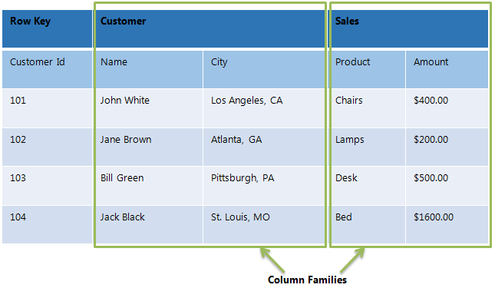

Slide 5
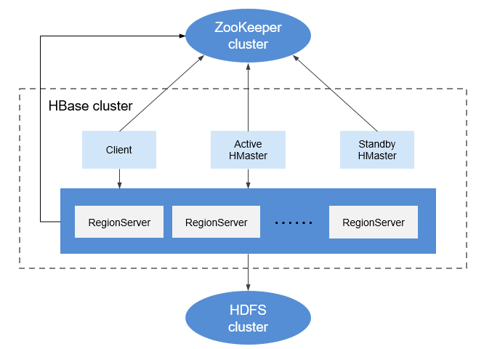
Scaling
HBase is horizontally scalable, meaning that it can handle a large amount of data by adding more nodes to the cluster

Slide 6
OLTP/OLAP
HBase is designed to be an OLTP (Online Transaction Processing) engine, allowing high-volume transactional operations. HBase is well-suited for real-time queries on large datasets and is optimized for OLTP. HBase is used for well over 100 different business use cases primarily OLTP workloads.
HBase is not designed for OLAP (Online Analytical Processing) workloads, which require complex queries and aggregations over large datasets. For OLAP workloads, Apache Hive is a better solution as it is mainly used for batch processing.

Slide 7
Designing for HBase
Designing for HBase involves understanding the data model and the various concepts at play in designing the schema.
HBase tables are collections of rows and column families, and rows are a collection of column families. Each table must have an element defined as a primary key, and the row key acts as the primary key in HBase.

Slide 8
Connecting
To connect to HBase via the command line, connect using the "hbase shell" command. Once you enter the HBase shell, you can execute all shell commands for table operations, table management, and data modeling.
To connect via PySpark, you can use the hbase-pyspark connector via Maven Repository. However, this connection only works with Spark 2.x versions, which was replaced by version 3 in April of 2019. There is also a python package called happybase, which could be used in lieu of PySpark.
HBase can connect to drill via the storage plugin through the Web UI at localhost:8047.

Slide 9
Lessons Learned/ Takeaways
Through this project, we learned how to create a docker-compose.yml file that contains HBase, Jupyter Notebook with PySpark, and Apache Drill.
We learned how to create tables through the CLI as well as how to read, update, and delete from them.
Additionally, learned how to connect HBase to drill to query tables and convert contents to readable format
It proved difficult to connect to PySpark, given HBase is archaic and development halted after the release of Spark 3.x
Had we had more time, we would’ve figured out how to configure the environment to get a connection to PySpark, so we could read and write data to HBase.

